Slide 1
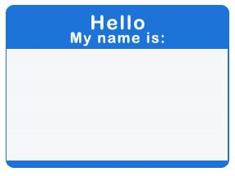
Welcome
Approved Training Providers
As you are settling in, please be sure to:
Copy the folder on the thumb drive found on your table to your desktop
Fill out nametag with the following:
First & Last Name
Name of District or Organization

Slide 2
Approved State Model Educator Evaluator Training
Day 1
Colorado Department of Education
Winter 2014
January/February 2014

Slide 3
Purpose of the Application
& Training
To help districts distribute leadership, manage workload and ensure high quality feedback to all educators, state statute and rule allow evaluator designees to conduct evaluations for teachers, principals and specialized service professionals as long as they have been through an evaluator training program approved by CDE. [22-9-106 (4) (a), 5.03 (B)]
This application and approval process is to meet the above need for the State Model Evaluation System
Applications will be approved for:
  An organization such as CASE, CEA, San Juan BOCES, Cherry Creek School District
  An individual such as a consultant

Slide 4
What are the steps to become an Approved State Model Educator Evaluator Training Provider?
CDE Trainer Intent
Prospective state model evaluation training providers submit intent and register for CDE training
CDE Approves Applications
CDE notifies approved providers
CDE Potential Providers are trained by CDE
Approved and trained providers are available for field training at district/requestor expense
Approved Providers Provide Field Training
CDE releases training opportunity for potential providers
CDE reviews applications and approves providers
Potential providers that have successfully completed the CDE training complete the application process by providing information on Requirement 1
CDE posts approved providers on the CDE website
Potential providers attend CDE training and successfully complete the training module
Provider must attend regular CDE update training and use CDE training materials
Annual CDE approval must be obtained by provider
Ongoing Evaluation by CDE on provider’s training

Slide 5
What does it mean to be an Approved Training Provider?
Components
  Requirement 1 – the “art” of evaluation
    Foundation evaluator skills (observation, feedback, etc.)
  Requirement 2 – the “science” of evaluation
    Technical aspects of state model system and tools
Participants
  Your training can be to qualify designees who don’t have a principal's or administrator’s license and they will be evaluating teachers, principals, or specialized service professionals
  Your training may also be provided to licensed evaluators who are new to the state model system or would like to deepen their expertise on either requirement 1 or requirement 2 components

Slide 6

Evaluator Trainees
What roles and responsibilities do you anticipate your evaluator trainees will have?
  Observe the professional practices
  Coach and provide feedback
  Help set targets and goals on Measures of Student Learning/Outcomes
  Help districts determine assessments and weights for Measures of Student Learning/Outcomes
  Sign off on evaluations
  Other (give example)
  I don’t know
If you are:
BOCES=Blue dot
School/District=Green dot
Consultant/Other=Red Dot

Slide 7
Ice Breaker
Thinking about evaluation experiences in your past…
  What did you want most from your evaluator?
Share your thinking with your table group
Be prepared to share the two most common themes

Slide 8
  By the end of these sessions, you will know how to train others on the following:
Agenda
  Day 1
  Critical Effects of S.B. 10-191
  Priorities of Implementation
  Evaluation Process
  Professional Practice
    Framework, Standards and Elements for:
      Principals
      Teachers
      Specialized Service Professionals
    Structure and Components of the rubrics
    Scoring the rubrics
  Day 2
  Homework Review
  Inter-rater Agreement
    Use of Elevate Colorado to develop inter-rater agreement
  Measures of Student Learning/Outcomes
  Determining Final Rating
  Next steps in application process

Slide 9
Housekeeping
Resources:
  PowerPoint
  Definitions of Effectiveness Document
  Planning Guide
  Thumb drive
  Parking Lot Posters
Check in:
  Make sure each person from your group has signed in
  Designate one primary contact person for each organization
  Verify your intent to submit an application

Slide 10
Session Orientation and Expectations
Interactive Sessions
  This is not a “sit and get” training
  How will you deliver this content to your participants?
Planning Guide
  Key messages
  Training strategies
  Resources
Day 1 Homework

Slide 11
Purposes of S.B. 10-191
A system to evaluate the effectiveness of licensed personnel and continually improve the quality of education and student outcomes.
Provide meaningful feedback for professional growth and continuous improvement.
Provide a basis for making decisions in the areas of hiring, compensation, promotion, assignment, professional development, earning and retaining non-probationary status, dismissal, and nonrenewal of contract.

Slide 12

Critical Effects of S.B. 10-191
Requires statewide minimum standards for what it means to be an _________ teacher, principal or specialized service professional
Requires ______ evaluation of all teachers, principals and specialized service professionals
Requires that all teachers and principals be evaluated at least ___% on the academic ______ of their students, also known as Measures of Student Learning
Requires that all Specialized Service Professionals be evaluated at least ___% on _________ of the students they support
“effective”
annual
50
growth
50
outcomes
Online
Resources

Slide 13
Critical Effects of S.B. 10-191
Changes non-probationary status from one that is ______ based upon years of ______ to one that is ______ based upon three consecutive years of demonstrated ____________
Provides that non-probationary status may be ___ based upon two consecutive years of ______________
Makes non-probationary status ________
Prohibits ______ placement of teachers
earned
service
earned
effectiveness
lost
ineffectiveness
“portable”
forced
Online
Resources

Slide 14
Priorities of Implementation
Human judgment
  Data should inform decisions, but human judgment will always be a part of the process
  Processes and techniques are recommended to improve individual judgment and minimize errors and bias
Embodiment of continuous improvement by monitoring
  Data from pilot and rollout intended to capture what works and what doesn’t
  Changes in assessment practices and tools
  Emerging research and best practices
Online
Resources

Slide 15
Priorities of Implementation
Providing credible and meaningful feedback with:
  Actionable information
  Opportunities for improvement
  Idea that this is a process and not an event
Involves all stakeholders in a collaborative process
  Families, teachers, related service providers, administration, school board, etc.
  Educators involved throughout development process
Online
Resources

Slide 16
Priorities of Implementation
Takes place within a larger, aligned and supportive system
  All components of the system must focus on increasing the number of educators and students who are successful
Turn and Talk
  Why is it important to share the priorities of implementation?
  What’s one of the most important messages that you want evaluators to take away?
Online
Resources

Slide 17
1.
Training
2.
Annual Orientation
9.
Goal-Setting and Performance Planning
3.
Self-Assessment
Evaluation Process for
Educators and
Practitioners
May 15
Within the first two weeks of school.
End of September.
Prior to the beginning of Spring Semester
Train: Prior to the beginning of School.
Orient: Within the first week of School.
End of May
Mid-June
End of June
8.
Final Ratings
4.
Review of Annual Goals and Performance Plan
7.
End-of-Year Review
5.
Mid-Year Review
6.
Evaluator Assessment
Online
Resources

Slide 18

Definition of Teacher Effectiveness
Effective teachers in the state of Colorado have the knowledge, skills, and commitments needed to provide excellent and equitable learning opportunities and growth for all students. They strive to support growth and development, close achievement gaps and to prepare diverse student populations for postsecondary and workforce success. Effective teachers facilitate mastery of content and skill development, and employ and adjust evidence-based strategies and approaches for students who are not achieving mastery and students who need acceleration. They also develop in students the skills, interests and abilities necessary to be lifelong learners, as well as for democratic and civic participation. Effective teachers communicate high expectations to students and their families and utilize diverse strategies to engage them in a mutually supportive teaching and learning environment. Because effective teachers understand that the work of ensuring meaningful learning opportunities for all students cannot happen in isolation, they engage in collaboration, continuous reflection, on-going learning and leadership within the profession.

Slide 19
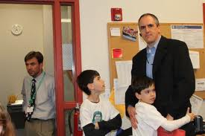
Definition of Principal Effectiveness
Effective Principals in the state of Colorado are responsible for the collective success of their schools, including the learning, growth and achievement of both students and staff. As schools’ primary instructional leaders, effective Principals enable critical discourse and data-driven reflection about curriculum, assessment, instruction, and student progress, and create structures to facilitate improvement. Effective Principals are adept at creating systems that maximize the utilization of resources and human capital, foster collaboration, and facilitate constructive change. By creating a common vision and articulating shared values, effective Principals lead and manage their schools in a manner that supports schools’ ability to promote equity and to continually improve their positive impact on students and families.

Slide 20
Definition of Specialized Service Professional Effectiveness
Effective specialized service professionals in the state of Colorado are vital members of the education team and have the knowledge and skills necessary to ensure that diverse student populations have equitable access to academic instruction and participation in school-related activities. Effective specialized service professionals develop and/or implement evidence-based services or specially designed instruction to meet the unique needs of their students. They support growth and development to close achievement gaps and prepare students for postsecondary and workforce success. They have a deep understanding of the interconnectedness of the home, school and community and collaborate with all members of the education team to strengthen those connections. Through reflection, advocacy, and leadership, they enhance the outcomes and development of their students.

Slide 21

Definitions of Effective Educators/Practitioners
Read each of the definitions and underline or circle words or phrases that express similar expectations.

Slide 22
STATE COUNCIL FOR EDUCATOR EFFECTIVENESS
Framework for System to Evaluate Teachers
Definition of Teacher Effectiveness
Quality Standards
I. Know Content
II. Establish Environment
III. Facilitate Learning
IV. Reflect on Practice
V. Demonstrate Leadership
VI. Student Growth
50% Professional Practice Standards 50% Student Growth Measures
Observations of Other Measures Teaching Aligned with
CDE Guidelines
Weighting: How Much Does Each Standard Count Towards Overall Performance?
State Other Assessments Other Measures
Summative for Non-tested Aligned with Assessments Areas CDE Guidelines
Match of test to teaching assignments
Weighting:
Scoring Framework: How Do Measures of Quality Standards
Result in a Determination of Individual Performance?
Performance Standards
Ineffective Partially Effective Effective Highly Effective
Appeals Process

Slide 23
STATE COUNCIL FOR EDUCATOR EFFECTIVENESS
Framework for System to Evaluate Principals
Definition of Principal Effectiveness
Quality Standards
I. Strategy
II. Instruction
III. Culture
IV. Human Resources
V. Management
VI. External Development
VII. Student Growth
50% Professional Practice Standards 50% Student Growth Measures
Number and Percentage Other Measures of Teachers Aligned with CDE Guidelines
Weighting: How Much Does Each Standard Count Towards Overall Performance?
School Performance Other Measures
Framework Aligned with CDE Guidelines
Weighting:
Scoring Framework: How Do Measures of Quality Standards
Result in a Determination of Individual Performance?
Performance Standards
Ineffective Partially Effective Effective Highly Effective

Slide 24
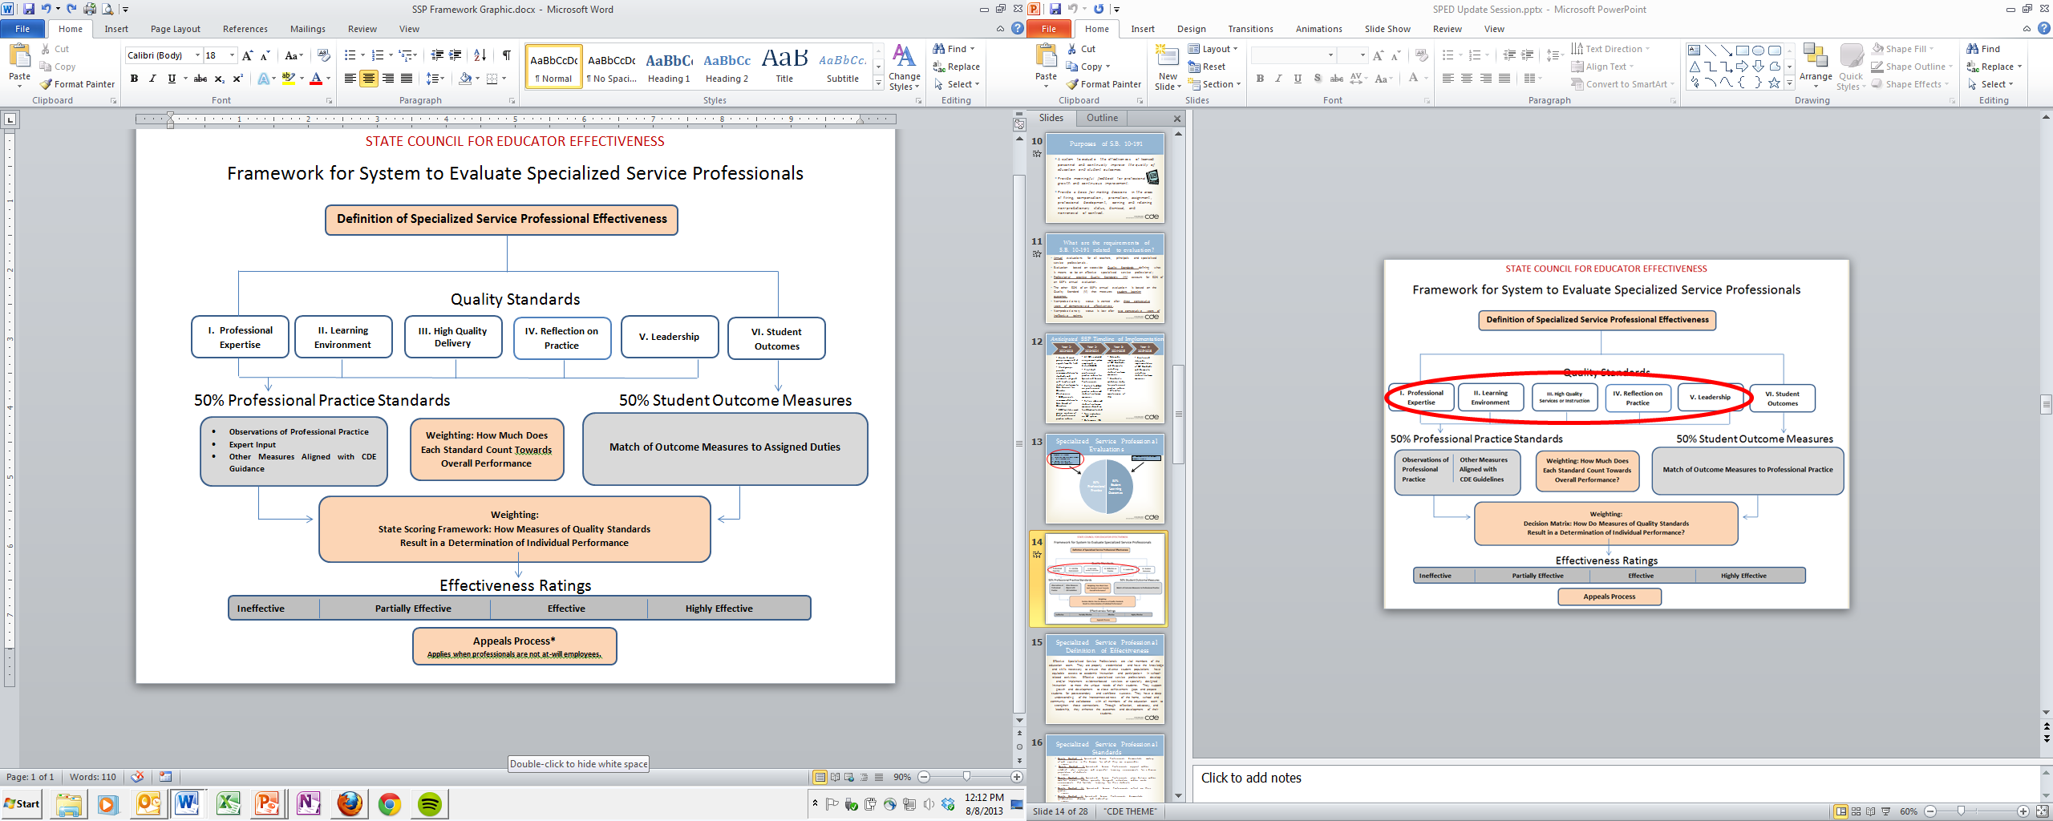

Slide 25

How do these systems align?
Create a visual that shows the similarities and differences among the principal, teacher, and specialized service professional standards.
Be prepared to share your thinking.

Slide 26
Reflection
What are key messages from this morning?
The Colorado State Model Educator Evaluation System is:
  Designed to improve educator effectiveness and student outcomes
  Is a continuous growth model that requires
    On-going, actionable feedback
    Professional development to support educators
What are other key messages you heard today?
What activities would you use to share these important messages?

Slide 27
State Model Rubric Basics
Standards based
  Cumulative in content
  Each level of the rubric represents an increase in the quality, intensity, consistency, breadth, depth, and complexity of practice
  Outlines the practices that you must meet to be at standard

Slide 28
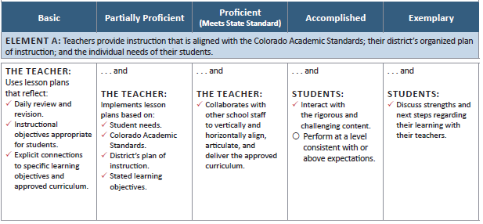
Rubric Structure and Rating Level Focus
The focus of the Basic rating is the educator whose performance does not meet state quality standards. The educator rated as Basic is typically performing at a foundational level. Every educator is expected to perform Basic professional practices in their day-to-day work.
The focus of Partially Proficient and Proficient levels is what educators do on a day-to-day basis to achieve state performance standards and assure that students are achieving at expected levels.
The focus of Accomplished and Exemplary ratings shifts to the outcomes of the educator’s practices, including expectations for staff, students, parents and community members, as a result of practices exhibited under rating levels 2 and 3.

Slide 29
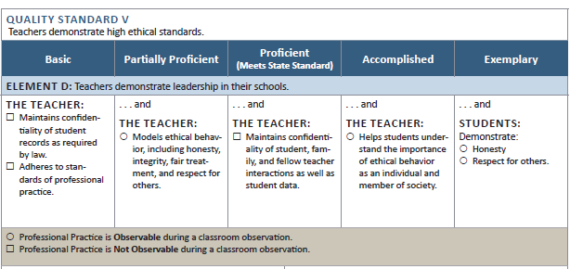
Components of the Rubric
Teacher Quality Standard
Performance
Rating Levels
Element of the Standard
Professional Practice is Not Observable
Professional Practice is Observable
Notes:
This slide orients participants to the components of the rubric. It is important that we use a common language to refer to each of the components to avoid confusion.

Slide 30
Scoring the Rubric
Determining the professional practices rating is a three-step process that involves rating the individual elements and standards and using those to determine the overall rating on professional practices.
  Rating the Elements
  Rating the Standards
  Determining the Overall Professional Practices Rating

Slide 31
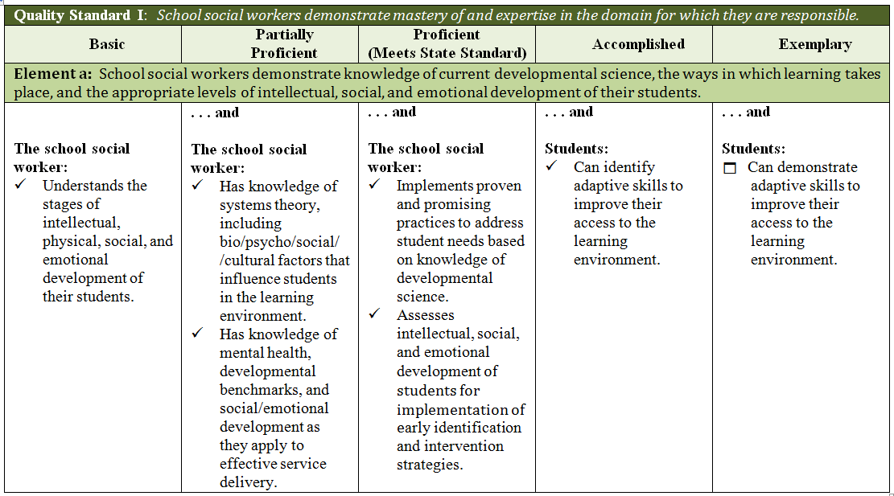
Understanding the Scoring
“Business” Rule
Starting in the Basic rating level and moving across, look for the first unchecked
professional practice. Move one column back to identify the rating for the element.

Slide 32
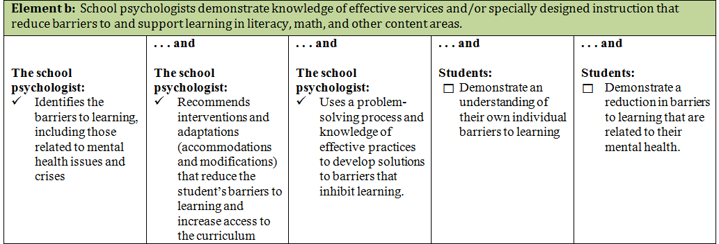
Determining the Element Rating
Starting in the Basic rating level and moving across, look for the first unchecked
professional practice. Move one column back to identify the rating for the element.

Slide 33
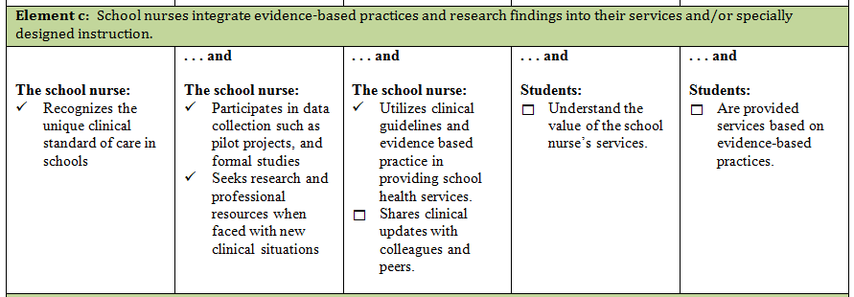
Determining the Element Rating
Starting in the Basic rating level and moving across, look for the first unchecked
professional practice. Move one column back to identify the rating for the element.

Slide 34
Rubric Rating Levels
Standard
Basic | Partially Proficient | Proficient | Accomplished | Exemplary
Element
Professional Practices | Professional Practices | Professional Practices | Professional Practices | Professional Practices
0
Educator’s performance on professional practices is significantly below the state performance standard.
1
Educator’s performance on professional practices is below the state performance standard.
2
Educator meets state performance standard.
3
Educator exceeds state standard.
4
Educator significantly exceeds state standard.

Slide 35
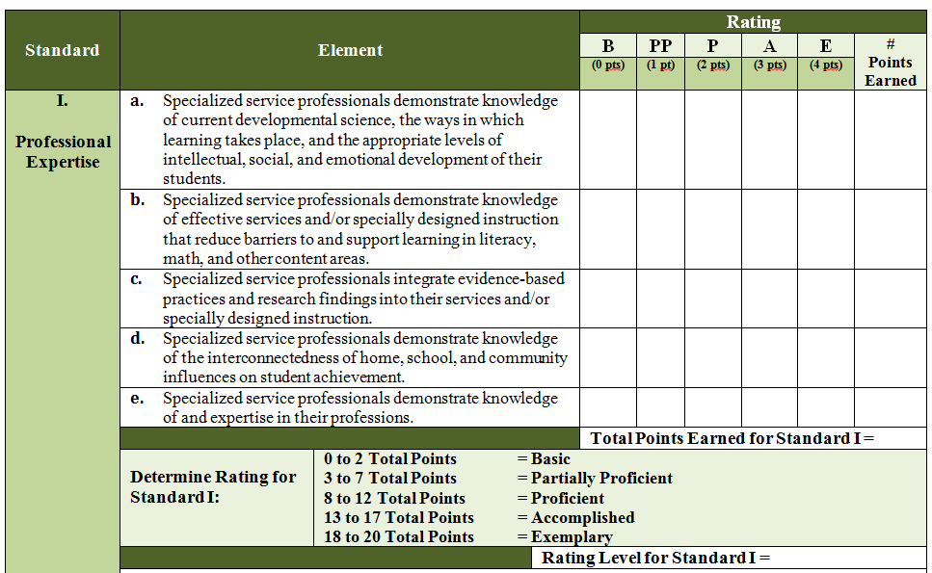
3
2
1
2
2
10
Proficient

Slide 36
Determining Overall Professional Practice Rating
First, determine each Standard’s contribution to the overall professional practice rating by using the following formula:
(Total Pts. Earned for Std.) X (Std. Weight X No. of Stds.)
(Number of Elements Associated with Standard)
Example:
10 X (.20 X 5)
5
= 2
Once you’ve completed this step for every Standard, you are then able to determine the overall professional practice rating.

Slide 37
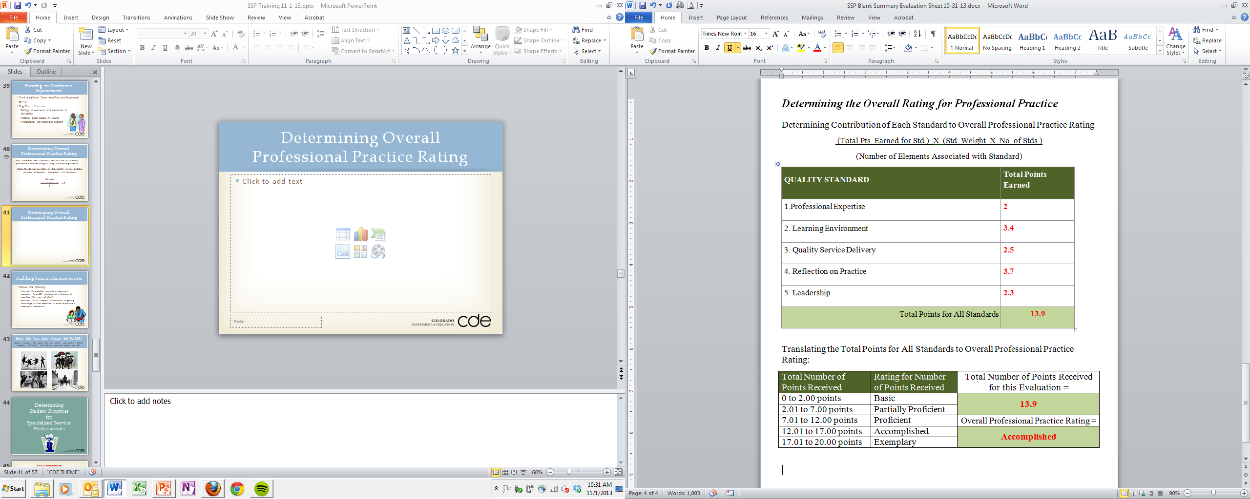
Determining Overall Professional Practice Rating

Slide 38
Making Sense of the Evaluation
Bridging Requirement 1 (Art of Evaluation) and Requirement 2 (Science of Evaluation)
  Simulation Activity
    Use a “scored” evaluation rubric to determine:
      Areas of strength and need
      Possible goals
      Coaching Conversation

Slide 39

Simulation Activity
Group Activity
Sample Rubrics (filled out by trained evaluators)
  Score the entire rubric
    Elements
    Standards
    Overall rating

Slide 40
Focusing on Continuous Improvement
  Look for areas of focus for goal setting.
    Record a goal(s) on your simulation
    What feedback would you give to support your claim?
  If this were a mid-year review, what additional artifacts would you look for to support evidence of the goal(s) set?
    Be prepared to share your thinking.

Slide 41
Inter-rater Agreement Systems
Understand the State Model Evaluation System
Understand the Standard, Elements and Professional Practices
Apply and Assess Learning
Purposes and Critical Effects of S.B. 10-191
Principals of Implementation
Evaluation Process
Structure and Components of the Rubric
How to Score the Rubric
Gallery Walk
Interactive Handbook
Elevate Colorado
Other

Slide 42
Understanding the Elements
Gallery Walk Activity
  Charts list each of the elements
  Participants are asked to read each element and provide an example of:
    What someone might do to make the element come alive
    What the result of that action is on students and staff, or artifacts that could be used as evidence of the practice
  Participants are asked to read the responses and look for:
    Commonalities among standards
    Areas in which they will need to develop a deeper understanding
  Take-away
    Build a common understanding of professional practices
    List of look fors
Online
Resources

Slide 43
Inter-rater Agreement
The Big Picture
Rules: 5.01 (G) A description of the process that the School District or BOCES used for validating the evaluation methods selected by the School District or BOCES. Such process shall address:
  5.01 (G) 1 consistency among the multiple measures used for evaluations
  5.01 (G) 2 inter-rater reliability when the measures are applied by different evaluators; and
  5.01 (G) 3 consistency of data used to evaluate performance (i.e., observation, surveys, Measures of Student Academic Growth) and the Performance Evaluation Ratings that are assigned.

Slide 44

IRR vs. IRA
Inter-rater Reliability (IRR)
  A measure of consistency between evaluators
    In regard to the ordering or relative standing of performance ratings
Inter-rater Agreement (IRA)
  A measure of consistency between evaluators
    In regard to the absolute value of ratings

Slide 45
Example of the Difference Between Reliability &Agreement
 | Low Agreement, High Reliability |  | High Agreement, High Reliability
 | Rater 1 | Rater 2 | Rater 3 | Rater 4
Teacher A | 1 | 2 | 1 | 1
Teacher B | 2 | 3 | 2 | 2
Teacher C | 3 | 4 | 3 | 3
Teacher D | 4 | 5 | 4 | 4
Agreement | 0.0 |  | 1.0
Reliability | 1.0 |  | 1.0

Slide 46
Inter-rater Agreement
Inter-rater agreement is based on a “criterion-referenced” interpretation of the ratings.
It is a measure of consistency between how frequently evaluators assign the same rating or an adjacent rating to an identical observable situation.
Evaluation ratings with better inter-rater agreement are more likely to be a credible source of performance feedback and basis for professional development planning because they are more likely to reflect true strengths and weaknesses rather than a rater’s opinion on a good educator practice.

Slide 47
Master Scoring
Background
  Administrators, district and teacher leaders
    Experienced with the State Model System and rubric
    Varied experience in content and grade level
  Summer Training
    Purpose: To come to consensus on high quality, explicit evidence at the professional practice level

Slide 48
Digging Into the Work
How do we define evidence?
A practice specifically linked to the video
  Std. 1.c15 – The teacher establishes an effective mathematics environment by requiring students to explain their solutions.
    Video evidence – Students were directed by teacher to work together to come up with a plan to solve the problem, individually write down their answer on their white board. The table captain was then asked to share out their answer to see if the group agreed.
A specific component of a lesson plan
  Std. 1a.1 – The teacher uses lesson plans that reflect daily review and revision.
    Lesson Plan evidence – Lesson Plan includes “Solve and Share” for CCSS review; Part 1, Re-teaching Worksheet 13-2

Slide 49
Digging Into the Work
How do we define evidence?
It is factual; does not include qualifiers or bias words
  Std. 1.b12 – The teacher integrates literacy skills into lessons, including listening skills.
    Qualified – This lesson is very structured…
    Biased – Humor used in the classroom is effective in keeping students on task.
It does not include any practice that requires the observer to infer
  Std. 2.f1 – The teacher provides clear expectations to guide student classroom behavior.
    Even if the classroom is well-managed, there may not be an example of the expectations the teacher set in the video. In this case, it makes sense to ask the teacher how he/she set expectations for classroom behavior.

Slide 50

Questions
What questions do you have about:
  Today’s content
  The requirements for designation as a State Model Educator Evaluation Training Provider

Slide 51
Homework
What resources will you need to fulfill Requirement 2 – The “science” of evaluation?
  Use your Planning Guide to assign topics to the people at your table.
  Each person will be responsible for reviewing their topic(s) using the EE Website Resources page to find resources and content for the 8 topics explored today.
    Record the resources found on your Planning Guide
    Be prepared to share with your table group what you found
      Highlight strengths and needs of the resources
  Day 2 will begin with time to discuss the resources you have found and answer any questions you have.

Slide 52
Preview for Day 2
Elevate Colorado
  Be sure to have created your account at www.mlpelevate.com
  If time, watch the tutorials at the bottom of each page
Use the EE Website Resources page to preview sections on:
  Inter-rater Agreement
    Elevate Colorado – bring headphones!
  MSL
    Download the demo Excel file using the link below:
      http://www.cde.state.co.us/educatoreffectiveness/smes-teacherexceldemo

Slide 53
Approved State Model Educator Evaluator Training
Day 2
Colorado Department of Education
Winter 2014
January/February 2014

Slide 54
  By the end of these sessions, you will know how to train others on the following:
Agenda
  Day 1
  Critical Effects of S.B. 10-191
  Priorities of Implementation
  Evaluation Process
  Professional Practice
    Framework, Standards and Elements for:
      Principals
      Teachers
      Specialized Service Professionals
    Structure and Components of the rubrics
    Scoring the rubrics
  Day 2
  Homework Review
  Inter-rater Agreement
    Use of Elevate Colorado to develop inter-rater agreement
  Measures of Student Learning/Outcomes
  Determining Final Rating
  Next steps in application process

Slide 55
Homework Review
Share your homework with your table group
  What resources did you identify on the planning guide for your topic?
  Were there any topics that you have additional resources for?
  Are there any topics that you would like additional support or resources for?

Slide 56
Expectations for Requirement 1
Concept, theory and best practices on supervision and evaluation
Including, but not limited to:
  Foundational evaluator skills
    Understanding teaching and learning styles
    The use of student performance and student assessment
    How to complete data collection and documentation
    Understanding the Colorado Academic standards
    Effectively using evaluation methods
    Engaging in conferencing strategies
    Giving effective feedback
    Creating and delivering written communications
    Building relationships and understanding when and how to use various observation techniques

Slide 57
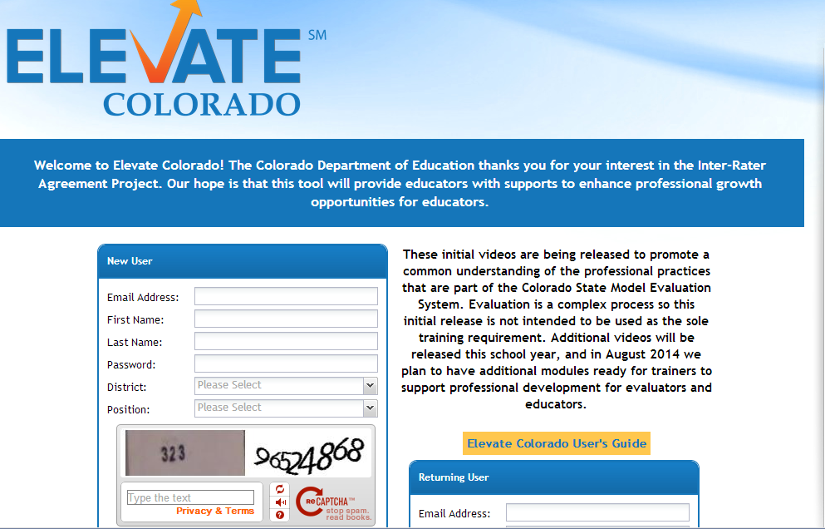
Elevate Colorado System Demo

Slide 58
Summary of the Elevate Colorado System
New Observation/Video Clip
  Play video
  Align evidence
Artifacts
  Lesson plan
  Teacher resources
Unaligned Evidence
  Any evidence not yet tagged to professional practices
    Realign/Edit/Delete
Evidence/Score
  Running record of evidence under each standard
Evidence Comparison
  A pdf to compare your evidence to master scores
  Feedback on system

Slide 59
Elevate Colorado Content Demo

Slide 60
Elevate Colorado Content
What process did you use to align the evidence?
What will you have to consider in training on evidence collection?
Use your planning to record your thinking.

Slide 61
Ways to Use Elevate Colorado
For Evaluator Training
Assign videos to watch individually or together using the “Facilitated training” feature
Once together, review the results, refer back to evidence in the video, and calibrate based on the master scores.
Include time for discussion to uncover inconsistencies and/or bias in observation as well as support consensus on what is high quality implementation of the Teacher Quality Standards.
Include a metric to determine proficient performance
In addition, these video clips can be used to generate discussion about the type of coaching conversations and support that could be offered to the teacher.

Slide 62
Metrics for Calibration
How do you know if you are meeting a level of proficiency in identifying professional practices?
Current research indicates that a minimum of 75% alignment is recommended. As you align evidence at the professional practices level to each video clip, you will be able to compare your response to that of the Master Scorers through the Evidence Comparison tab.
Remember that Master Scorers sought to include only explicit, quality evidence for each practice. In other words, try not to infer what is happening, but what is visible in teacher and student actions.
Keep in mind that we are not yet using this system to determine an overall professional practice rating. These 10-15 minute video clips would not provide sufficient evidence because of the ongoing nature of evaluation process over a full school year.

Slide 63
Training Modules
Inter-rater agreement sections and modules:
Section 1: Understanding the requirements and components of the Colorado State Model Evaluation System
  Module 1: Introduction to the Colorado State Model Evaluation System
  Module 2: Understanding How to Score the Rubric
  Module 3: Applying Best Practices in Using the Rubric

Slide 64
Training Modules
Section 2: A deeper dive into the Colorado Teacher Quality Standards
  Module:
    Standard I
    Standard II
    Standard III
    Standard IV
    Standard V
    Standard VI (tentative)
Section 3: Applying and assessing learning with Elevate Colorado

Slide 65
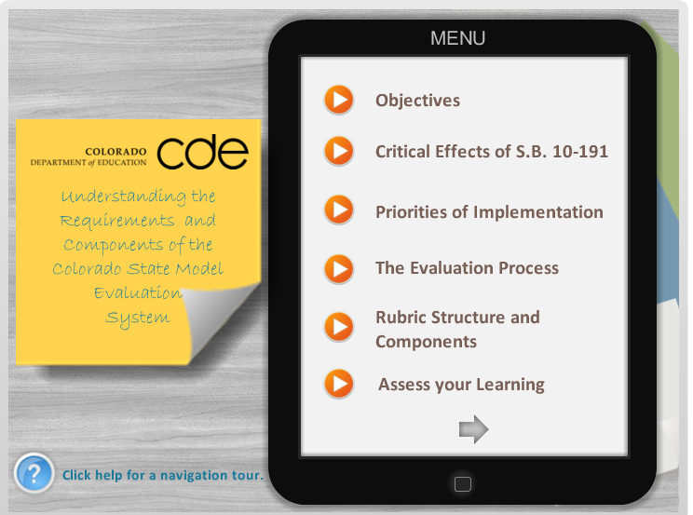
Section 1: Module 1 Example
https://cloud.scorm.com/sc/InvitationConfirmEmail?publicInvitationId=3d654736-3c56-41f7-af80-f40289223901

Slide 66
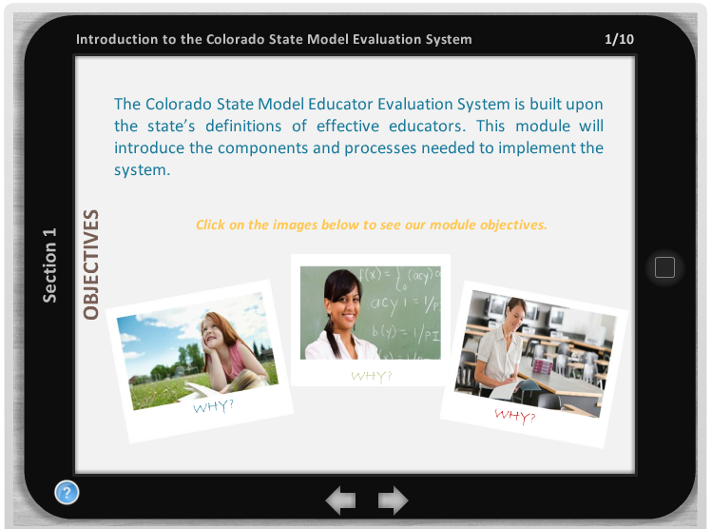

Slide 67
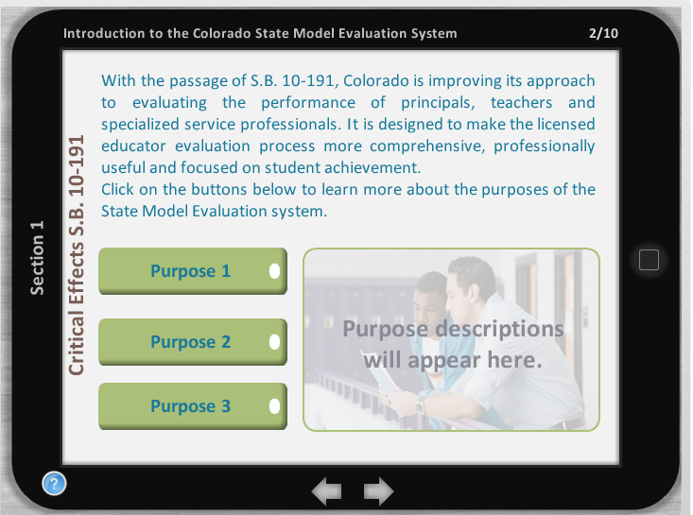

Slide 68
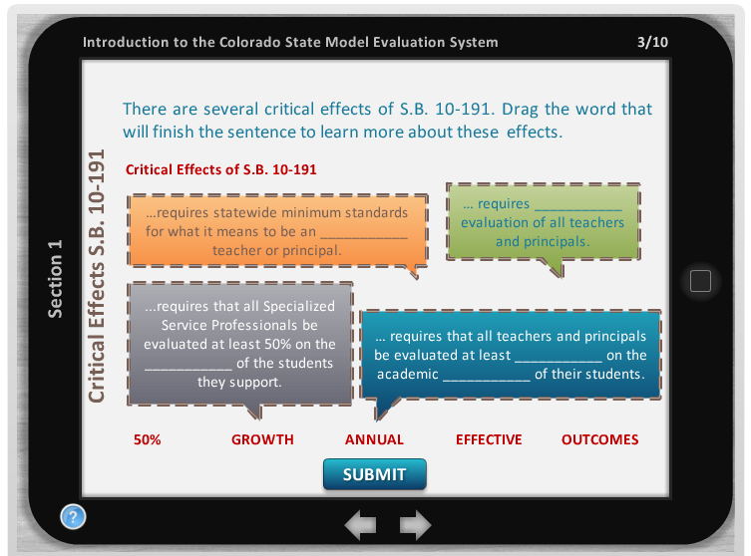

Slide 69
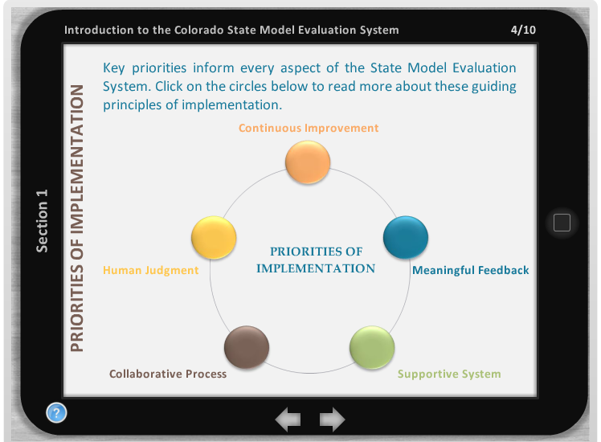

Slide 70
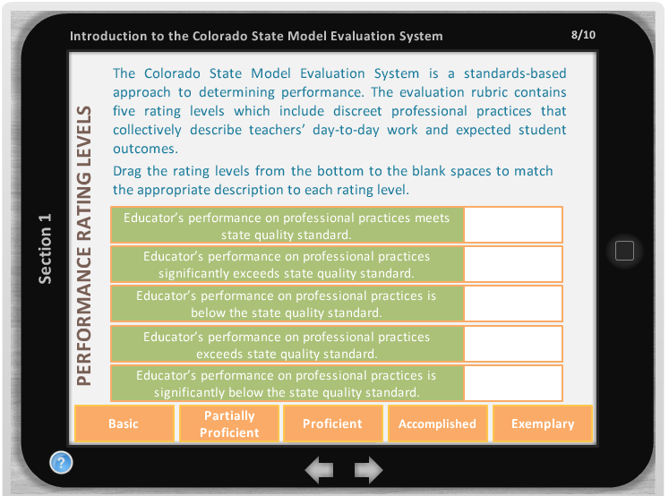

Slide 71


Slide 72
Questions
What questions do you have about:
  Inter-rater Agreement
  Elevate Colorado
  OpenPD
  Other
Record your thinking on your planning guide.
  How can this system support your work in training evaluators?

Slide 73
Measures of Student Learning and Outcomes

Slide 74
Include any new district or school decisions for measuring Student Learning Outcomes
1.
Training
2.
Annual Orientation
9.
Goal-Setting and Performance Planning
3.
Self-Assessment
Evaluation Process for
Educators and
Practitioners
Confirm measures used to determine Student Learning Outcomes – Finalize baseline data
May 15
Within the first two weeks of school.
End of September.
Prior to the beginning of Spring Semester
Train: Prior to the beginning of School.
Orient: Within the first week of School.
End of May
Mid-June
End of June
8.
Final Ratings
4.
Review of Annual Goals and Performance Plan
Review available data from measures to determine if students are on track
Review and finalize compiled results of outcome measures
7.
End-of-Year Review
5.
Mid-Year Review
6.
Evaluator Assessment
Online
Resources

Slide 75
The “Other 50%”
We’ve focused on the professional practice portion of the evaluation system.
Now, it’s time to transition to the other half - Measures of Student Learning or Student Outcomes.
50% Professional Practice
50% Measures of Student Learning/ Outcomes

Slide 76
Measures of Student Learning/Outcomes
What’s on your mind?
What questions do you have about the “other 50%” of the state model evaluation system?
Are there specific topics that you want covered?
Take a moment to discuss and record these questions in your group. We’ll check in again to make sure that your questions have been addressed.

Slide 77
Measures of Student Learning/Outcomes
So what do you need to know?
This is complicated.
Why?
Because this depends entirely on who you are training, who they are evaluating, what their responsibilities are, and what decisions have already been made.
If you need more explanation or detail once you begin your “deep dive” then we will partner with you directly and provide further technical assistance or training to meet your needs.

Slide 78
Measures of Student Learning/Outcomes
What portion of MSL will the people that you train be responsible for?
Developing the framework / pie for a school or district
Developing the framework for individual groups of educators
Selecting and weighting measures
Helping educators to set targets and goals for their measures
Coaching conversations with educators around measures and results
“I don’t know”
Turn and Talk: What will the people that you train be primarily responsible for?

Slide 79
From Student Academic Growth
to
Measures of Student Learning / Outcomes
Measures of Student Learning / Outcomes
Using multiple measures to determine student learning over time.
Colorado Growth Model (CGM) establishes technical measure of “growth.”

Slide 80
Understanding the Rules and Law
Something for everyone
What does the “other 50%” of the evaluations system look like for…
Teachers?
Principals?
Specialized Service Professionals?

Slide 81
STATE COUNCIL FOR EDUCATOR EFFECTIVENESS
Framework for System to Evaluate Teachers
Definition of Teacher Effectiveness
Quality Standards
I. Know Content
II. Establish Environment
III. Facilitate Learning
IV. Reflect on Practice
V. Demonstrate Leadership
VI. Student Growth
50% Professional Practice Standards 50% Student Growth Measures
Observations of Other Measures Teaching Aligned with
CDE Guidelines
Weighting: How Much Does Each Standard Count Towards Overall Performance?
State Other Assessments Other Measures
Summative for Non-tested Aligned with Assessments Areas CDE Guidelines
Match of test to teaching assignments
Weighting:
Scoring Framework: How Do Measures of Quality Standards
Result in a Determination of Individual Performance?
Performance Standards
Ineffective Partially Effective Effective Highly Effective
Appeals Process

Slide 82
Teacher Quality Standard VI
A measure of individually-attributed growth,
A measure of collectively-attributed growth;
When available, statewide summative assessment results; and
For subjects with statewide summative assessment results available in two consecutive grades, results from the Colorado Growth Model.

Slide 83
STATE COUNCIL FOR EDUCATOR EFFECTIVENESS
Framework for System to Evaluate Principals
Definition of Principal Effectiveness
Quality Standards
I. Strategy
II. Instruction
III. Culture
IV. Human Resources
V. Management
VI. External Development
VII. Student Growth
50% Professional Practice Standards 50% Student Growth Measures
Number and Percentage Other Measures of Teachers Aligned with CDE Guidelines
Weighting: How Much Does Each Standard Count Towards Overall Performance?
School Performance Other Measures
Framework Aligned with CDE Guidelines
Weighting:
Scoring Framework: How Do Measures of Quality Standards
Result in a Determination of Individual Performance?
Performance Standards
Ineffective Partially Effective Effective Highly Effective

Slide 84
Principal Quality Standard VII
Requirement 1: Measure to be included
  School Districts and BOCES shall ensure that data included in the school performance framework, required pursuant to section 22-11-204, C.R.S., is used to evaluate Principal performance. School Districts and BOCES may choose to weight specific components of the school performance framework differently than they are weighted in the school performance framework, depending on the Principal’s responsibilities and the performance needs of the school, so long as student longitudinal growth carries the greatest weight.
Requirement 2: Measure to be included
  School Districts and BOCES shall incorporate at least one other Measure of Student Academic Growth and must ensure that the Measures of Student Academic Growth selected for Principal evaluations are consistent with the Measures of Student Academic Growth used for the evaluation of Teachers in each Principal’s school.
Requirement 3: Measures shall reflect subjects beyond state assessed
  Measures of Student Academic Growth shall reflect the growth of students in all subject areas and grades, not only those in subjects and grades that are tested using Statewide Summative Assessments, and shall reflect the broader responsibility a Principal has for ensuring the overall outcomes of students in the building.

Slide 86
Specialized Service Professionals Quality Standard VI
Requirement language from State Board rules:
    At least fifty percent of the evaluation shall be based on at least two measures of student outcomes, which measures shall be aligned with the role and duties and the individual SSP being evaluated

Slide 87
How do these systems align?
Create a visual that shows the similarities and differences among the measures of student learning / outcomes for principal, teacher, specialized service professionals.
Be prepared to share your thinking.

Slide 88
A teacher, a principal, and an SSP walk into a bar….
...and decide to look at each other’s 50% Measures of Student Learning/Outcomes.
What do they find?
Take a moment to look at the 3 samples on your table.
Evaluate each sample to determine if it meets the requirements.

Slide 89
Measures of Student Learning/Outcomes
Coaching Conversations
What might some evaluators need to be able to do?
  Help educators select and weight multiple measures
What do all evaluators need to be able to do?
  Help educators set targets and scales
  Discuss the results of these targets and scales and possibly readjust over time
  Help ensure that the measures focus the conversation on student learning and student outcomes
What will the people that you train need the most assistance with?

Slide 90
Approaches for Selecting and Using Multiple Measures in Teacher Evaluation
Step 1: Begin with the Colorado Academic Standards
Step 2: Identify available assessments used to evaluate student learning throughout the year
Step 3: Group available assessments according to teacher type
Step 4: Select and preliminarily weight assessments for use in educator evaluations
Step 5: Determine how the results from the selected student learning measures will be scaled for expected growth
Step 6: Combine weighted scores into a measures of student learning rating
Measures of Student Learning Guidance for Districts V 2.0

Slide 91
Measures of Student Learning/Outcomes
The link to principals' guidance on growth and specialized service professionals’ outcomes:
  http://www.cde.state.co.us/educatoreffectiveness/studentgrowthguide

Slide 92
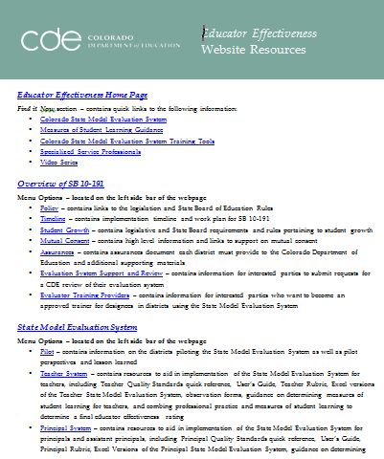
Highlighted Resources
(Please refer to your Educator Effectiveness Website Resources for a complete list)
Measures of Student Learning Guidance
Full Day Growth Training
Assessment Inventory
Assessment Review Tool
CDE Resource Bank
Target and Scale Setting Activity
Demo Excel System

Slide 93
Using Local Assessments in Evaluation
Districts, BOCES and schools may decide after completing the Assessment Inventory that a locally created assessment would likely be included as a measure in evaluation.
Districts and BOCES can use the Assessment Review Tool to show they are taking steps to ensure that the locally created measurements they select are fair, valid, and reliable.

Slide 94
Assessment Review Tool
  Assessment Review Tool
Criteria used in this tool:
  Alignment
  Scoring
  Fair and Unbiased
  Opportunities to Learn

Slide 95
Assessment Support
Content Collaboratives
P-12 educators from around the state gathered to identify and create a high-quality assessment resource bank, which is aligned to the new Colorado Academic Standards and may be used in the context of Educator Effectiveness evaluations.
The Content Collaboratives, CDE, along with state and national experts, will establish examples of student learning measures within each K – 12 content area including:
Cohort I
Dance | Drama & Theatre Arts | Music | Reading, Writing and Communicating
Social Studies |  | Visual Arts
Cohort II
Physical Education | Science | World Languages | Comprehensive Health
Mathematics |  | CTE

Slide 96
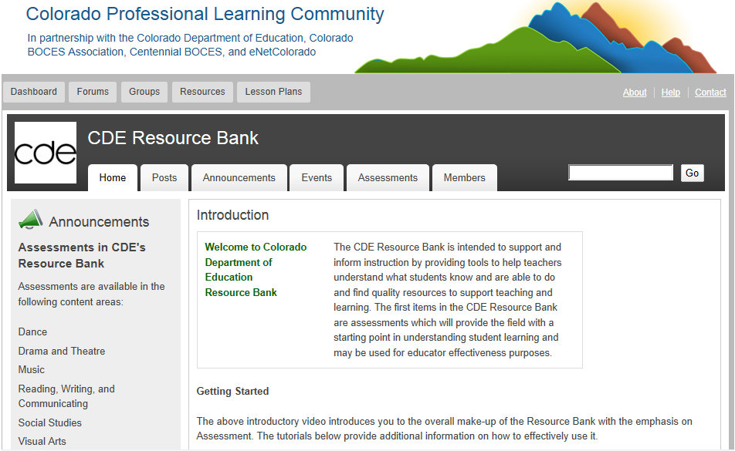

Slide 97
Measures of Student Learning/Outcomes
Coaching Conversations
What do all evaluators need to be able to do?
  Help educators set targets and scales
  Discuss the results of these targets and scales and possibly readjust over time
  Help ensure that the measures focus the conversation on student learning and student outcomes

Slide 98
Approaches for Selecting and Using Multiple Measures in Teacher Evaluation
Step 1: Begin with the Colorado Academic Standards
Step 2: Identify available assessments used to evaluate student learning throughout the year
Step 3: Group available assessments according to teacher type
Step 4: Select and preliminarily weight assessments for use in educator evaluations
Step 5: Determine how the results from the selected student learning measures will be scaled for expected growth
Step 6: Combine weighted scores into a measures of student learning rating
Measures of Student Learning Guidance for Districts V 2.0

Slide 99
Setting Targets and Scales
Finding Balance
Rigorous Attainable

Slide 100
Student Learning Objective Process
What is the Student Learning Objective Process?
  Enables educators to utilize academic standards to establish learning outcomes for students, monitor progress and evaluate the degree to which students achieve those outcomes
  In educator evaluation systems, this process serves as a method of measuring student growth, progress or mastery of the standards

Slide 101
Student Learning Objective Process
The essential steps of the Student Learning Objective Process include:
Understanding the Colorado Academic Standards in order to select learning outcomes
Collecting baseline information to inform target and scale setting
Assessing quality, attainment level and rigor of student learning targets and scales
Monitoring student learning (formative practice)
Determining attainment of student learning targets and scales
Reflecting and refining the Student Learning Objective Process

Slide 102
Student Learning Objective Process
Understanding the Colorado Academic Standards
Selecting Learning Outcomes
Procuring or Developing Assessments Using Quality Criteria
Collecting Baseline Information
Setting Student Learning Targets
Setting Appropriate Scales for Measurement
Assessing Quality, Attainment Level and Rigor of Student Learning Targets and Scales
Monitoring Student Learning (Formative Practice)
Determining Attainment of Student Learning Targets and Scales
Reflecting and Refining Student Learning Objective Process

Slide 103
Student Learning Objective Process
Understanding the Colorado Academic Standards
Selecting Learning Outcomes for Target Setting
Procuring or Developing Assessments Using Quality Criteria
Turn and Talk:
Why is it important to start the Student Learning Objective process with the Colorado Academic Standards?
How does this first step support the work done in professional practice?
What tool is in place to support you with part of this process?

Slide 104
Student Learning Objective
Process
THE PROCESS OF: Understanding the Colorado Academic Standards
Selecting Learning Outcomes for Target Setting
THE PROCESS OF: Collecting Baseline Information
Setting Student Learning Targets
Setting Appropriate Scales for Measurement
Procuring or Developing Assessments Using Quality Criteria

Slide 105
Student Learning Objective Process:
Strategies for Target Setting
Possible strategies to consider when determining how students will be captured when target setting:
  Individual – Teacher sets individual goals for students and then determines how many students met their individual goals
  Whole Class – Teacher sets a goal that would be applied to all students in a class
  Subgroup of Students – Teacher sets a goal for a group(s) of students with similar baseline data levels
  Case Load – Teacher sets a goal for the specific students he or she supports
  Some of these strategies may work better with some teaching assignments. Can you think of which teaching assignments might work best with which strategy based on your local context?

Slide 106
Possible Student Learning Targets and Scales
Examples of Student Learning Targets and Scales:
16 of my 21 students will increase their reading proficiency by 1-2 grade levels.
9 more students will receive + at the end of the year.
The median score on my end of course assessment last year was 73%. At the end of the course for this year, the median score will be at least 78%.

Slide 107
Student Learning Objective Process:
Strategies for Target Setting
Possible strategies to consider when setting learning targets for students: All targets are indicators of growth using a variety of data sources:
  Proficiency data Targets – students meeting grade level expectations
    Examples: a % of students will pass the end-of-course exam; a % of students will score a 3 or better on the AP exam
  Growth data Targets – students growing over the course of instruction
    Examples: a % of students will progress one fitness level; a % of students will make projected growth or better on the MAP assessment
  Averaging data Targets – students’ average score on an assessment
    Example: Students will answer, on average, 80% of the questions correctly on the end-of-course exam

Slide 108
Possible Student Learning Targets
What are the targets in these examples?
16 of my 21 students will increase their reading proficiency by 1-2 grade levels.
9 more students will receive + at the end of the year.
The median score on my end of course assessment last year was 73%. At the end of the course for this year, the median score will be at least 78%.

Slide 109
Student Learning Objective Process:
Strategies for Scale Setting
Teachers set ranges (how many students are expected to meet the set target) across 4 rating levels: above expected, expected, less than expected, and much less than expected
Teachers collaboratively set ranges with their evaluator
  Ranges will vary from year to year and possibly class to class as baseline data will vary due to student beginning points
  Collaboratively setting ranges will allow teachers and evaluators to calibrate about expected student learning outcomes

Slide 110
Student Learning Objective Process:
Strategies for Scale Setting
You can use the Measures of Student Learning Tool to record the targets and scales you have established.
When Colorado Growth Model data is available the scale indicating expected student learning outcomes has been established for you.

Slide 111
Possible Student Learning Scales
What are the scales in these examples?
16 of my 21 students will increase their reading proficiency by 1-2 grade levels.
9 more students will receive + at the end of the year.
The median score on my end of course assessment last year was 73%. At the end of the course for this year, the median score will be at least 78%.

Slide 112
Student Learning Objective Process: Target Setting Practice
With a partner, use the Setting Student Learning Targets and Scales worksheet to analyze one set of data.
  Portfolio/Performance Outcomes
  Baseline Reading Levels
  End of Course Summative Exam Results
  Rubric Outcomes
Practice setting a student learning outcome target for expected outcomes.

Slide 113
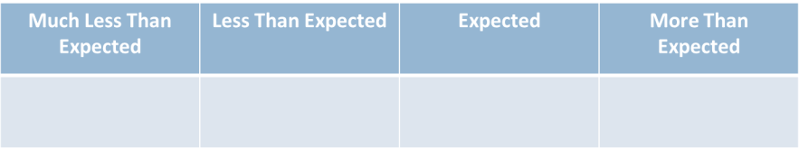
Student Learning Objective Process:
Scale Setting Practice
Think about what your expected outcomes are (targets).
Establish the ranges for each of the categories below.
How did you decide on the ranges?
Are your expectations rigorous, yet attainable?

Slide 114
Student Learning Objective Process:
Target and Scale Setting
  ALL 4 sets of data
  Performance Assessment/Portfolio Outcomes
  Reading Levels (beginning of the year)
  Cumulative exam
  Rubric Results
+ | √ | - | √ | + | √ | - | √ | + | √ | - | √ | √ | + | - | √ | - | + | + | - | √
18 | 24 | 24 | 30 | 38 | 40 | 40 | 50 | 50 | 50 | 50 | 50 | 60 | 60 | 60 | 60 | 70 | 70 | 70 | 80 | 80
66 | 89 | 68 | 75 | 74 | 80 | 94 | 99 | 60 | 55 | 71 | 73 | 95 | 96 | 84 | 82 | 79 | 81 | 98 | 74 | 86
6 | 4 | 1 | 5 | 5 | 2 | 6 | 2 | 5 | 2 | 1 | 6 | 3 | 3 | 5 | 3 | 1 | 2 | 6 | 4 | 4

Slide 115
Student Learning Objective
Process
Understanding the Colorado Academic Standards
Selecting Learning Outcomes for Target Setting
Procuring or Developing Assessments Using Quality Criteria
THE PROCESS OF: Collecting Baseline Information
Setting Student Learning Targets
Setting Appropriate Scales for Measurement
Assessing Quality, Attainment Level and Rigor of Student Learning Targets and Scales

Slide 116
A teacher, a principal, and an SSP walk into a bar….
...and decide to look at each other’s 50% Measures of Student Learning/Outcomes.
What do they find?
Take a moment to look at the 3 samples on your table.
Evaluate each sample to determine if it meets the requirements.
How might these be strengthened and/or modified?
Discuss your analysis at the table and be prepared to share out.

Slide 117
Student Learning Objective Process:
Determine Target and Scale Quality
Will your evaluators establish quality criteria for the use of Student Learning Targets and Scales?
Criteria for establishing quality targets and scales might include:
  Approval processes
  Collaboratively established
  Level of attainment
  Rigor
  Based on previous data
  Meet or exceed past student performance

Slide 118
Student Learning Objective
Process
Understanding the Colorado Academic Standards
Selecting Learning Outcomes for Target Setting
Procuring or Developing Assessments Using Quality Criteria
Collecting Baseline Information
Setting Student Learning Targets
Setting Appropriate Scales for Measurement
Assessing Quality, Attainment Level and Rigor of Student Learning Targets and Scales
Monitoring Student Learning (Formative Practice)
Determining Attainment of Student Learning Targets and Scales

Slide 119
Student Learning Targets:
Reflection on Pre and Post Data
  Performance Assessment/Portfolio Outcomes
  Reading Levels (beginning of the year)
  End of year cumulative exam
  Rubric results
+ | √ | √ | + | - | √ | √ | + | + | √ | √ | + | + | + | ₊ | - | √ | √ | + | √ | +
30 | 40 | 38 | 38 | 50 | 50 | 50 | 60 | 50 | 60 | 70 | 70 | 60 | 70 | 70 | 80 | 80 | 70 | 80 | 80 | 80
75 | 90 | 76 | 89 | 80 | 99 | 90 | 91 | 80 | 70 | 82 | 79 | 94 | 95 | 98 | 95 | 66 | 87 | 98 | 85 | 71
5 | 5 | 3 | 6 | 6 | 4 | 3 | 5 | 6 | 6 | 4 | 5 | 4 | 4 | 6 | 5 | 3 | 6 | 5 | 6 | 5

Slide 120
Student Learning Objective Process
Understanding the Colorado Academic Standards
Selecting Learning Outcomes for Target Setting
Procuring or Developing Assessments Using Quality Criteria
Collecting Baseline Information
Setting Student Learning Targets
Setting Appropriate Scales for Measurement
Assessing Quality, Attainment Level and Rigor of Student Learning Targets and Scales
Monitoring Student Learning (Formative Practice)
Determining Attainment of Student Learning Targets and Scales
Reflecting and Refining Student Learning Objective Process

Slide 121
Considerations when Setting Student Learning Targets
Assessment literacy of educators creating targets
Data literacy of educators
Time and effort required of teacher and evaluator
Focus of school or district (all students and/or subgroups of students)
Available information or data in school or district
Ease or readiness level of teachers and evaluators
Possible approval process of strategies selected
Number of targets wanted as a district/building

Slide 122
Reflection
What are the key messages? Use your planning guide to record the key messages, training strategies and resources available that you will likely use in your training.
Will you need to train your evaluators on managing this process? What additional ideas do you have for making the Student Learning Objective Process more manageable?
How will you support your trainees with assessment and data literacy?

Slide 123
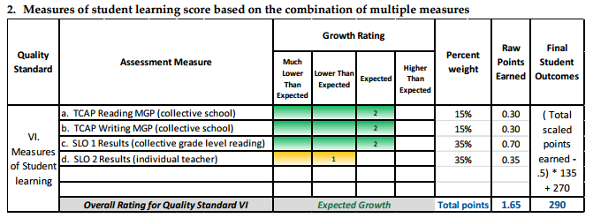
Combining Outcomes
Draft Secondary Example

Slide 124
Decision Framework
Putting It All Together
  The Decision Framework helps districts aggregate the 50% Professional Practices and the 50% Measures of Student Learning to reach a final rating of one of the following:
    Highly Effective
    Effective
    Partially Effective
    Ineffective

Slide 125
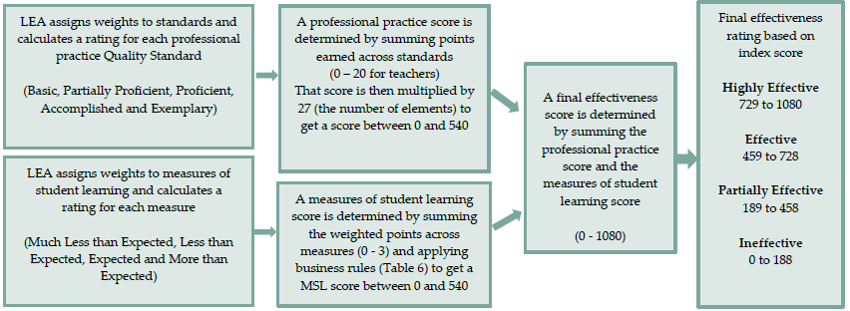
Process for Assigning Effectiveness Ratings

Slide 126
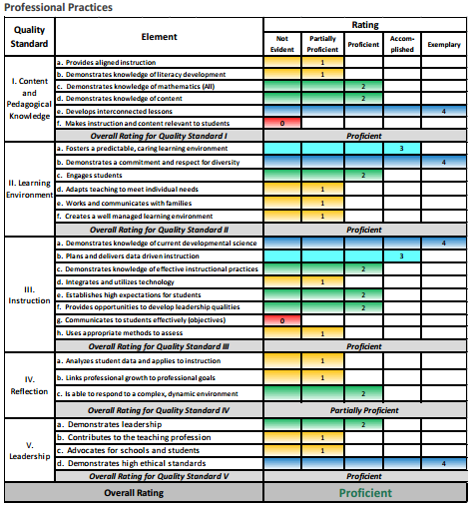
Professional Practices Report

Slide 127
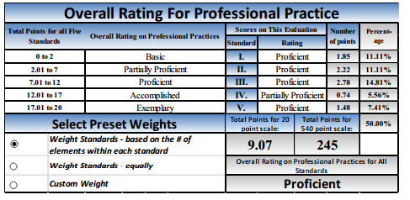
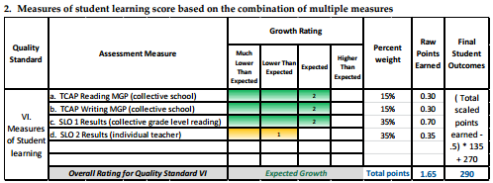

Slide 128
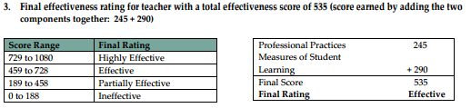

Slide 129
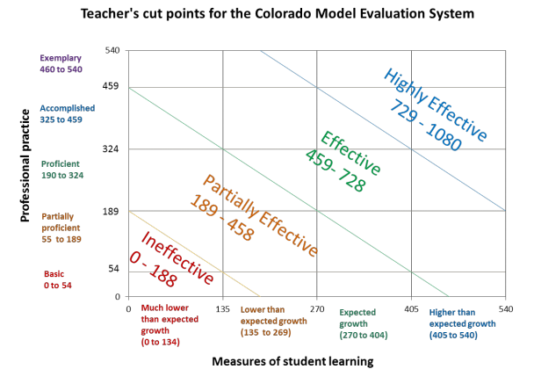

Slide 130
Evaluators and
“The other 50%”
What are the most important messages about the decision framework that you want evaluators to take away
How will you ensure that evaluators have the tools and training to meet these needs?

Slide 131
Becoming and Staying a State Approved Trainer
Application Process – Next Steps
  Application is due to CDE by March 7th
    Complete application https://www.surveymonkey.com/s/eestatemodelfinalapp
    Print and complete the Certifications Form, including signatures. Return that form only via email to Mary Bivens at bivens_m@cde.state.co.us.
  CDE notification of approval by March 28th
  Approved providers will be posted on the CDE Website for others to contact you and provide training on April 1st
Ongoing Evaluation and training
  CDE ongoing evaluation and quality control of trainings
  Yearly orientation, periodic training, use of updates and tools for the State Model System

Slide 132
Becoming and Staying a State Approved Trainer, cont.
Data to submit to CDE
  Number of trainings, number of evaluators trained, number of evaluators certified (successfully completed your training)
    Provider will be responsible for keeping details of designee names, training participation, and certification information on file for CDE reference as requested
  Elevate program statistics (IRA information)
  Participant feedback on quality of training

Slide 133
Becoming and Staying a State Approved Trainer, cont.
Certification/approval of Designees
  Provider determines success criteria for certification/approval of their program including, at minimum, the following components:
    Understanding the technical elements and scoring of the State Model System
    Identification of Professional Practices
    Inter-rater agreement
    Providing meaningful feedback to educators
Questions about the Application Process
Mary Bivens, bivens_m@cde.state.co.us, 303-866-5194 or Tricia Majors, majors_t@cde.state.co.us, 303-866-6678

Slide 134
Final Questions
What questions do you have?

Slide 135
Contact Us
  EE Leadership
  Katy Anthes: Executive Director
    Anthes_K@cde.state.co.us
  Toby King: Director
    King_T@cde.state.co.us
  Jean Williams: Rubric Evaluation Specialist
    Williams_J@cde.state.co.us
  Communications
  Amy Skinner
    Skinner_A@cde.state.co.us
  Katie Lams
    Lams_K@cde.state.co.us
  Britt Wilkenfeld: Data Fellow
    Wilkenfeld_B@cde.state.co.us
  Tricia Majors: Project Mgr.
    Majors_T@cde.state.co.us

Slide 136
Contact Us
Implementation Support and Development
  Mary Bivens
    Bivens_M@cde.state.co.us
  Courtney Cabrera
    Cabrera_C@cde.state.co.us
  Sed Keller
    Keller_S@cde.state.co.us
  Dawn Paré
    Pare_D@cde.state.co.us
  Bob Snead
    Snead_B@cde.state.co.us
  Chris Vance
    Vance_C@cde.state.co.us

